Slide 1
Impressionism
Varsha Sarveshwar – period 3, 3/19/14

Slide 2
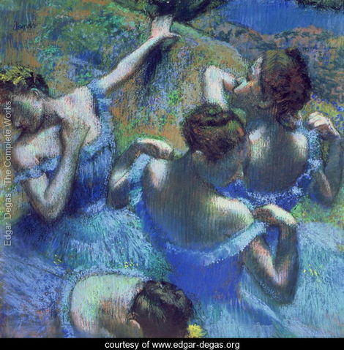
Impressionism – the basics
Impressionism was an art movement, originating in Paris in the 1870s that was characterized by vivid colors, bright lights, and broad brushstrokes.
Blue Dancers – Edgar Degas

Slide 3
A brief timeline the beginnings of impressionism
1863 – Edouard Manet’s Olympia causes public outrage and works are rejected
1863 – Emperor Napoleon III orders the Salon des Refusés for rejected artists
1874 – The Anonymous Society of Painters, Scultors, Printmakers, etc. hold a salon

Slide 4
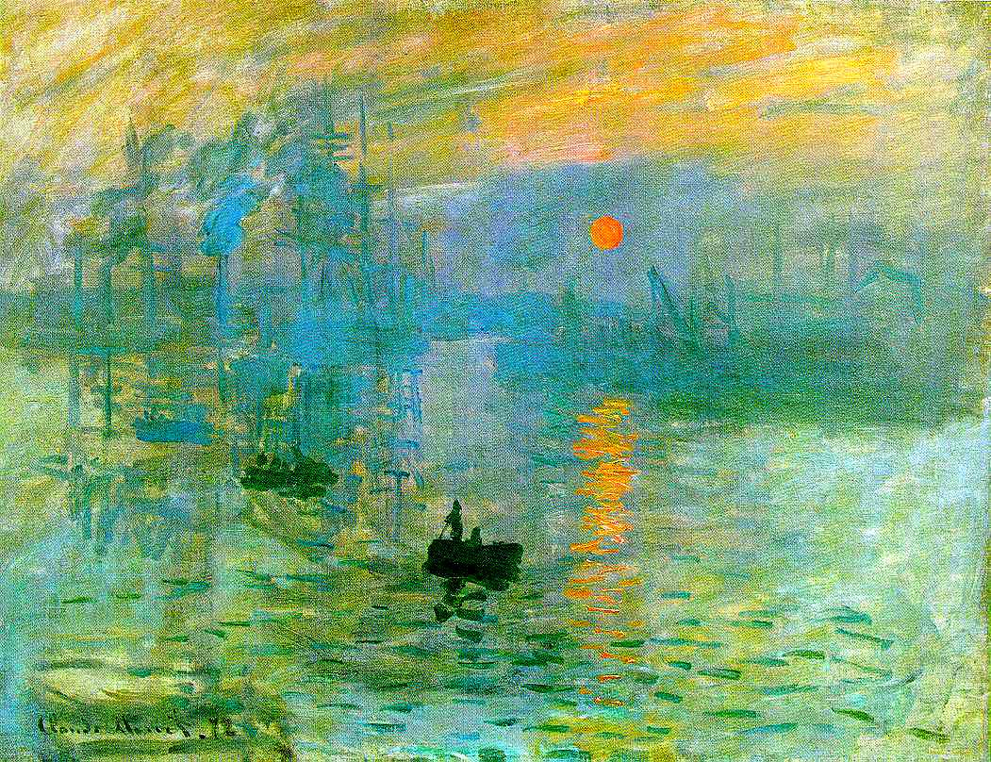
The 1874 salon
held in Paris by the Anonymous Society of Painters, Scultors, Printmakers, etc.
Founding members: Claude Monet, Edgar Degas, and Camille Pissarro
Critic Louis Leroy gave the movement its name after accusing Monet’s Impression, Sunrise of being an impression
Impression, Sunrise – Claude Monet

Slide 5
Louis Leroy’s Criticisms
“The poor man rambled on this way quite peacefully, and nothing led me to anticipate the unfortunate accident which was to be the result of his visit to this hair-raising exhibition. He even sustained, without major injury, viewing the Fishing Boats Leaving the Harbor by M. Claude Monet, perhaps because I tore him away from dangerous contemplation of this work before the small, noxious figures in the foreground could produce their effect.”
- Louis Leroy, “Exhibition of the Impressionists”

Slide 6
Techniques in impressionism
En Plein Air
  French for “open air,” signifies painting outdoors
  Originated in England w/ painter John Constable
  Expanded by Impressionist painters
    Ready-made paint tubes and easels, which were available by the late nineteenth century, spurred en plein air painting
    En plein air painting in the Impressionist movement led to an interest in the play of light and complementary colors
“I’m chasing the merest sliver of color… It’s terrible how the light runs out, taking color with it.” – Claude Monet

Slide 7
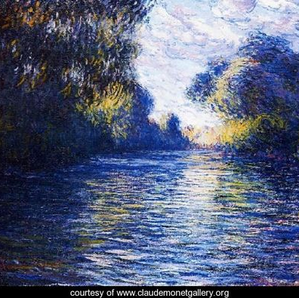
Themes in impressionism
Common Motifs/Themes
  everyday life
  joyful, playful scenes
  the play of sunlight on water
  capturing a single moment
Morning on the Seine – Claude Monet

Slide 8
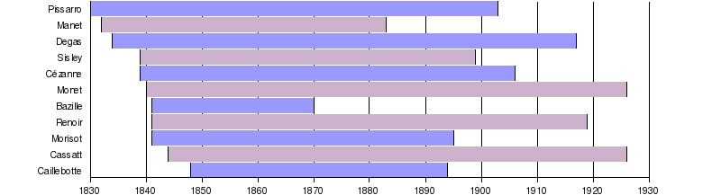
The lives of the impressionists

Slide 9
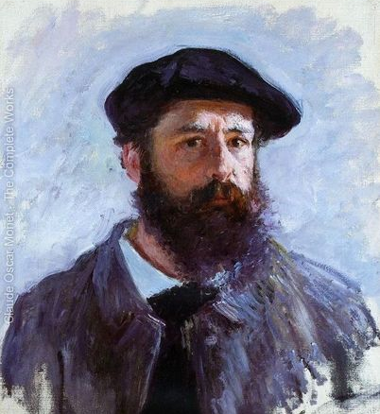
Impressionist artists claude monet
Click for more paintings!
Oscar-Claude Monet (1840 – 1926)
French Impressionist Painter, centered in Paris
Learned en plein air techniques from Eugéne Boudin
Focused on plays of light and color
Self-Portrait – Claude Monet

Slide 10
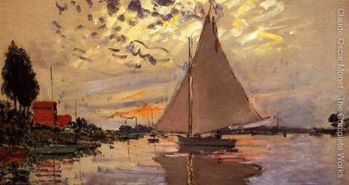
Impressionist artists claude Monet
Sailboat at Le Petit Gennevilliers– Claude Monet

Slide 11
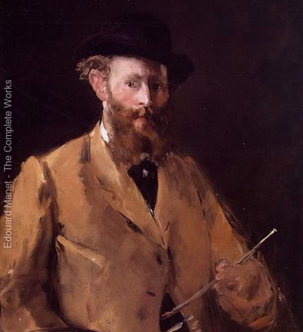
Impressionist artists
Edouard manet
Click for more paintings!
Edouard Manet (1832 – 1883)
French Impressionist Painter, centered in Paris
His Olympia and The Luncheon on the Grass garnered immense controversy and were turning points for Impressionism
Self-Portrait – Edouard Manet

Slide 12
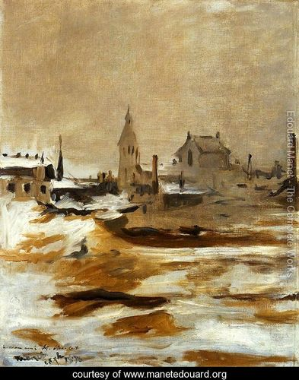
Impressionist artists edouard manet
Effect of Snow at Petit Montrouge – Edouard Manet

Slide 13
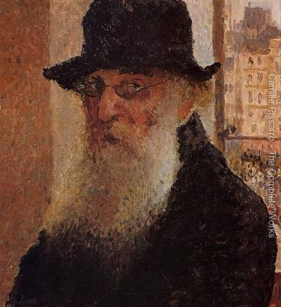
Impressionist artists
Camille pissarro
Click for more paintings!
Camille Pissarro (1830 – 1903)
French Impressionist Painter, resided in St. Thomas
Contributed to Post-Impressionism as well
Self-Portrait – Camille Pissarro

Slide 14
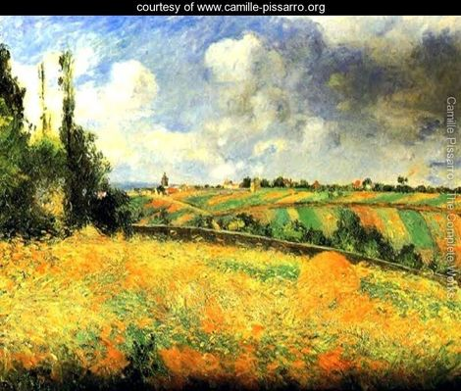
Impressionist artists
Camille pissarro
Fields– Camille Pissarro

Slide 15
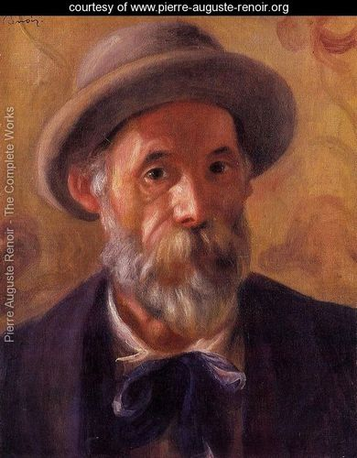
Impressionist artists pierre-auguste renoir
Click for more paintings!
Pierre-Auguste Renoir (1841 – 1919)
French Impressionist Painter
Traveled extensively, finally settled in Cagnes-sur-Mer
Paintings were warm and playful in tone
Self-Portrait – Pierre-Auguste Renoir

Slide 16
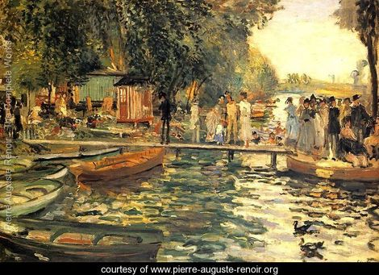
Impressionist artists pierre-auguste renoir
La Grenouillere – Pierre-Auguste Renoir

Slide 17
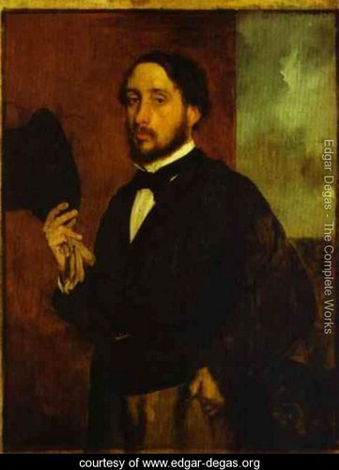
Impressionist artists edgar degas
Click for more paintings!
Edgar Degas (1834 – 1917)
French Impressionist Painter
Hated the term Impressionist, preferring to be called a realist
Most paintings feature dancers
Self-Portrait – Edgar Degas

Slide 18
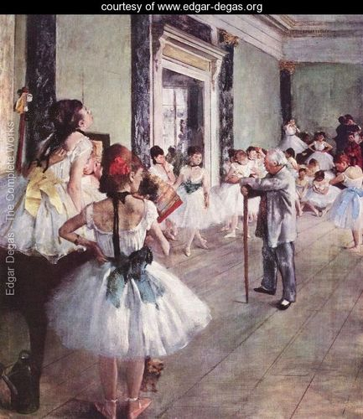
Impressionist artists edgar degas
The Dance Class – Edgar Degas

Slide 19
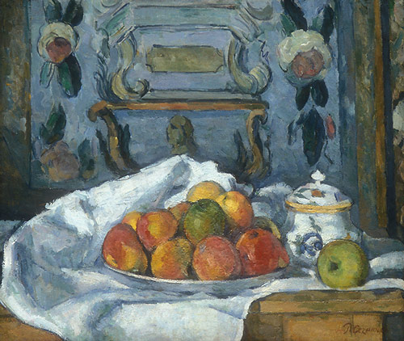
The transition to post-impressionism
Post-Impressionism
  Began in 1880s
  Pushback against themes of Impressionism
  More abstract than Impressionism
  Post-Impressionist painters: Paul Cézanne, Vincent van Gogh, Georges Seurat
Dish of Apples – Paul Cézanne

Slide 20
Works cited
“Blue Dancers.” Edgar-degas.org. Edgar-degas.org, n.d. Web. 18 Mar. 2014.
Boddy-Evans, Marion. “The Painting by Monet That Gave Impressionism its Name.” About.com. About.com, n.d. Web.
18 Mar. 2014.
Boddy-Evans, Marion. “Art Glossary: Salon des Refusés.” About.com. About.com, n.d. Web. 18 Mar. 2014.
Boddy-Evans, Marion. “Techniques of the Impressionists – What Colors are Shadows?” About.com. About.com, n.d.
Web. 18 Mar. 2014.
“Camille Pissarro – The Complete Works.” Camille-pissarro.org. Camille-pissarro.org, n.d. Web. 18 Mar. 2014.
“Claude Monet (1840-1926).” Metmuseum.org. The Metropolitan Museum of Art, n.d. Web. 18 Mar. 2014.
“Claude Oscar Monet – The Complete Works.” Claudemonetgallery.org. Claudemonetgallery.org, n.d. Web. 18 Mar.
2014.
“The Dance Class 1873-76 – Edgar Degas.” Edgar-degas.org. Edgar-degas.org, n.d. Web. 18 Mar. 2014.
“Edgar Degas – The Complete Works.” Edgar-degas.org. Edgar-degas.org, n.d. Web. 18 Mar. 2014.
“Edouard Manet – The Complete Works.” Manetedouard.org. Manetedouard.org, n.d. Web. 18 Mar. 2014.
“Effect of Snow at Petit Montrouge – Edouard Manet.” Manetedouard.org. Manetedouard.org, n.d. Web. 18
Mar. 2014.
“Fields – Camille Pissarro.” Camille-pissarro.org. Camille-pissarro.org, n.d. Web. 18 Mar. 2014.

Slide 21
Works cited
“First Impressionist Exhibit – Contemporary Criticism.” Artchive.com. N.p., n.d. Web. 18 Mar. 2014.
“Impressionism: Art and Modernity.” Metmuseum.org. The Metropolitan Museum of Art, n.d. Web. 18 Mar. 2014.
“Impression Sunrise by Claude Monet.” Claude-monet.com. Claude-monet.com, n.d. Web. 18 Mar. 2014.
“Information reviews about Impressionism.” Impressionism.org. Impressionism.org, n.d. Web. 18 Mar. 2014.
“La Grenouillere – Pierre Auguste Renoir.” Pierre-auguste-renoir.org. Pierre-auguste-renoir.org, n.d. Web. 18 Mar. 2014.
“Morning On The Seine 2 – Claude Oscar Monet.” Claudemonetgallery.org. Claudemonetgallery.org, n.d. Web. 18 Mar. 2014.
“Paul Cézanne: Dish of Apples.” Metmuseum.org. The Metropolitan Museum of Art, n.d. Web. 18 Mar. 2014.
“Pierre Auguste Renoir Biography.” Pierre-auguste-renoir.org. Pierre-auguste-renoir.org, n.d. Web. 18 Mar. 2014.
“Plein Air Painting – Impressionist artists.” Askart.com. AskART, n.d. Web. 18 Mar. 2014.
“Post-Impressionism.” Metmuseum.org. The Metropolitan Museum of Art, n.d. Web. 18 Mar. 2014.
“Sailboat At Le Petit Gennevilliers – Claude Oscar Monet.” Claudemonetgallery.org. Claudemonetgallery.org, n.d. Web. 18 Mar.
2014.
“Self Portrait 2 – Edgar Degas.” Edgar-degas.org. Edgar-degas.org, n.d. Web. 18 Mar. 2014.
“Self Portrait I – Camille Pissarro.” Camille-pissarro.org. Camille-pissarro.org, n.d. Web. 18 Mar. 2014.
“Self Portrait – Pierre Auguste Renoir.” Pierre-auguste-renoir.org. Pierre-auguste-renoir.org, n.d. Web. 18 Mar. 2014.
“Self Portrait With A Beret – Claude Oscar Monet.” Claudemonetgallery.org. Claudemonetgallery.org, n.d. Web. 18 Mar. 2014.
“Self Portrait With A Palette – Edouard Manet.” Manetedouard.org. Manetedouard.org, n.d. Web. 18 Mar. 2014.
“Timeline: Lives of the Impressionists.” Wikipedia.org. Wikipedia.org, n.d. Web. 18 Mar. 2014.

